Slide 1



VIRTUAL SUPRA SAE INDIA 2015

Slide 2
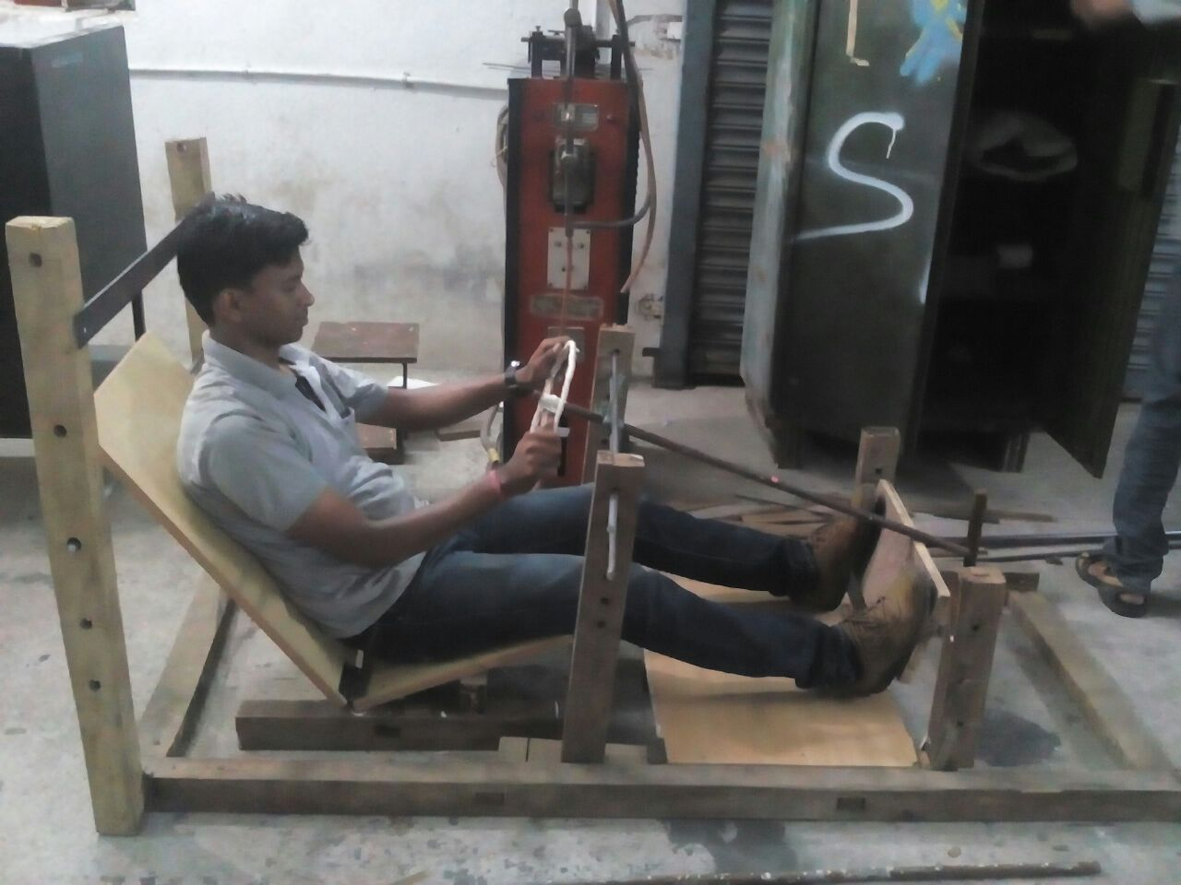
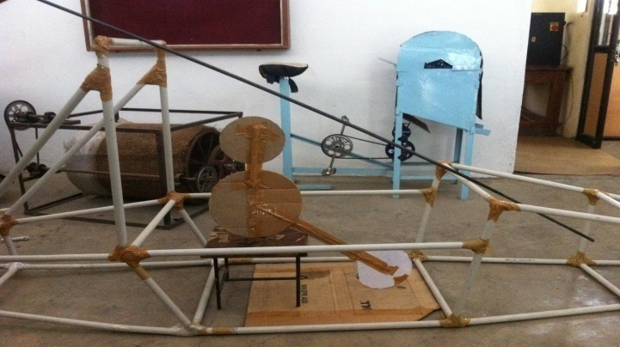
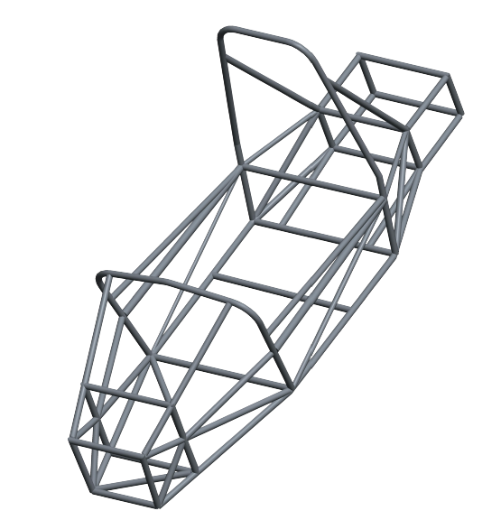
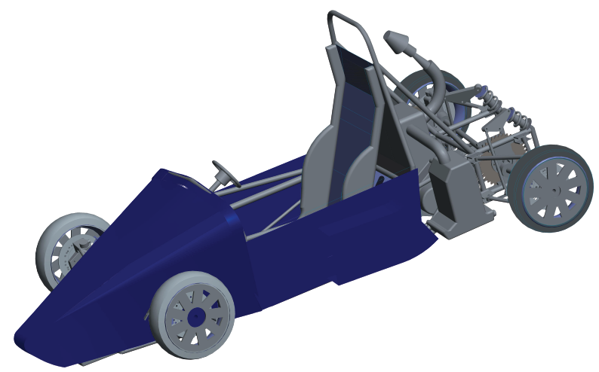
CHASSIS DESIGN METHODOLOGY
ERGONOMICS APPARATUS
PVC PROTOTYPE
CREO MODEL
ACTUAL MODEL

Slide 3
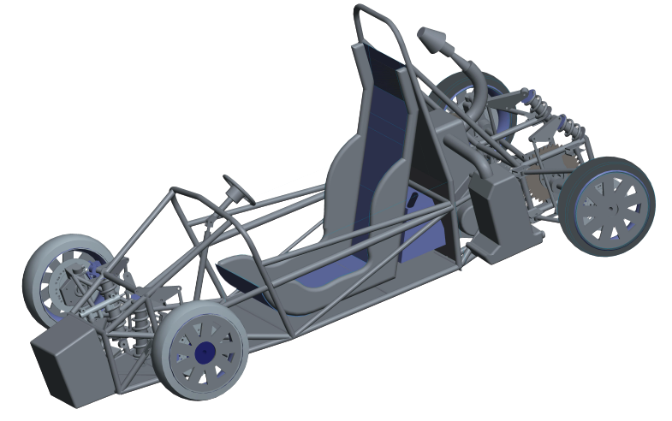
VEHICLE 3D VIEW

Slide 4
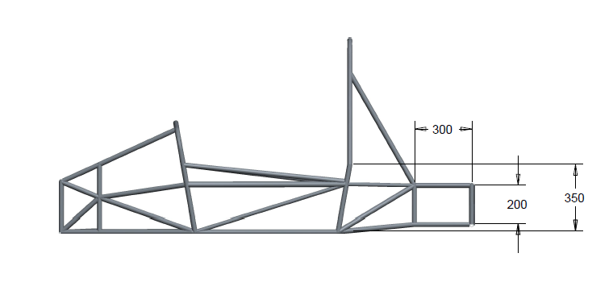
CHASSIS / ROLL CAGE
CREO 2.0 was exercised to design the 3-D model
of the roll cage
SPECIFICATION:-
OD 25.4mm X 2.4mm wall thickness
Side impact member attached at a height of 330mm.
Maximum round corners for stress redistribution
Weld thickness = 2.3 mm (MIG Welding)
Material specification:-
Material used- SAE 1018
Density - 7.758 g/cm3
Modulus of Elasticity - 205 GPa
Ultimate Tensile Strength - 440 MPa
Tensile Yield Strength: - 370 Mpa
Poisson’s ratio- 0.29

Slide 5
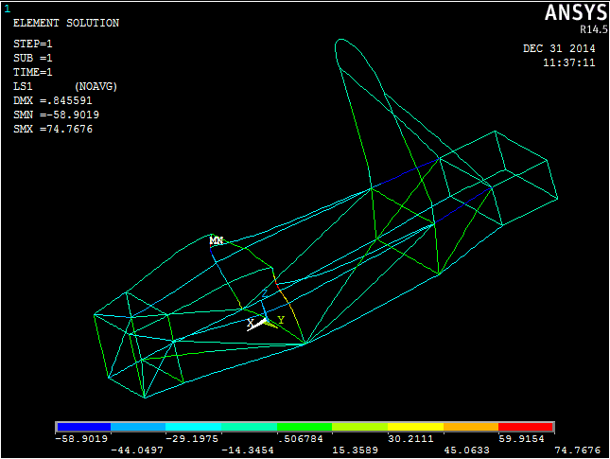
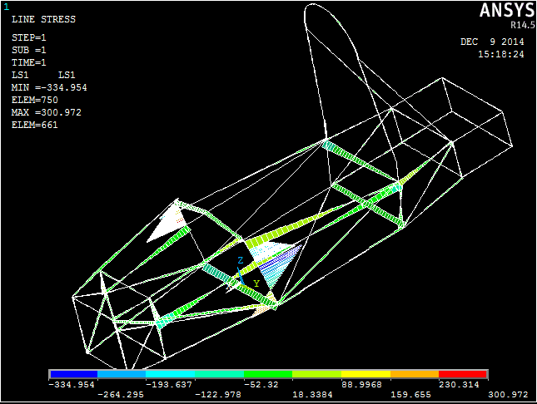
CHASSIS ANSYS DIAGRAMS
Front impact:-
Force applied-30000N
Points constrained- all degrees of freedom of rear pick points of A-Arm
FOS- 5.06
Side impact:-
Force applied- 22000N
Points constrained- all degree of freedom of side impact members
FOS-1.13

Slide 6
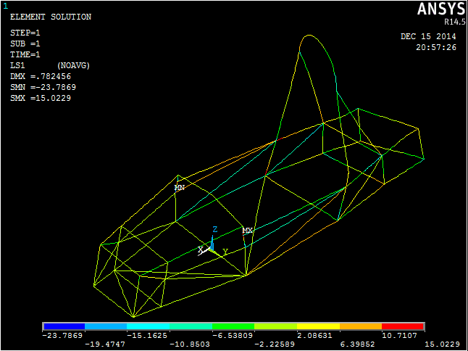
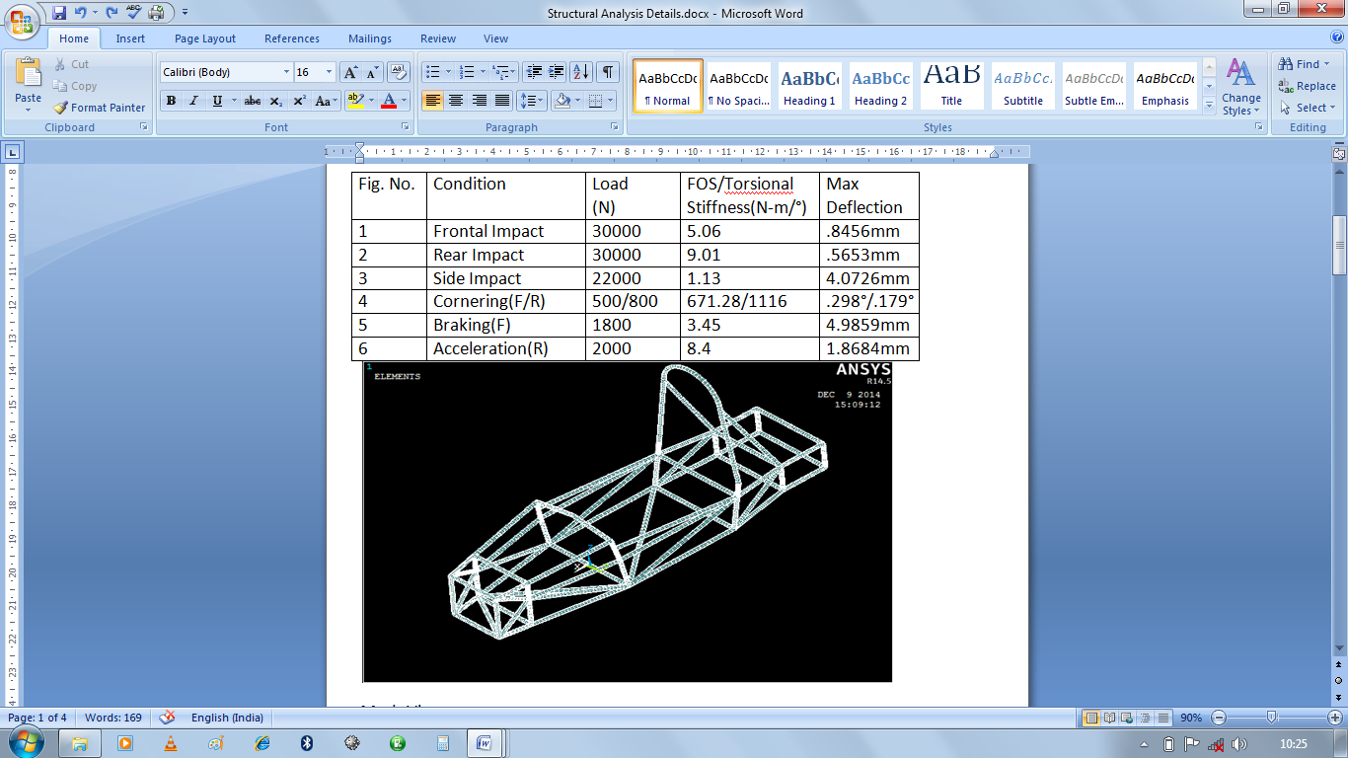
CHASSIS ANSYS DIAGRAMS
Torsional stiffness:-
Force applied-800N at suspension point
Max Deflection observed- 0.179deg
Torsional stiffness- 1116 Nm/deg
Attenuator:-
To prevent sudden impacts, Aluminium attenuator with 20 KJ energy absorbing capacity is incorporated.

Slide 7
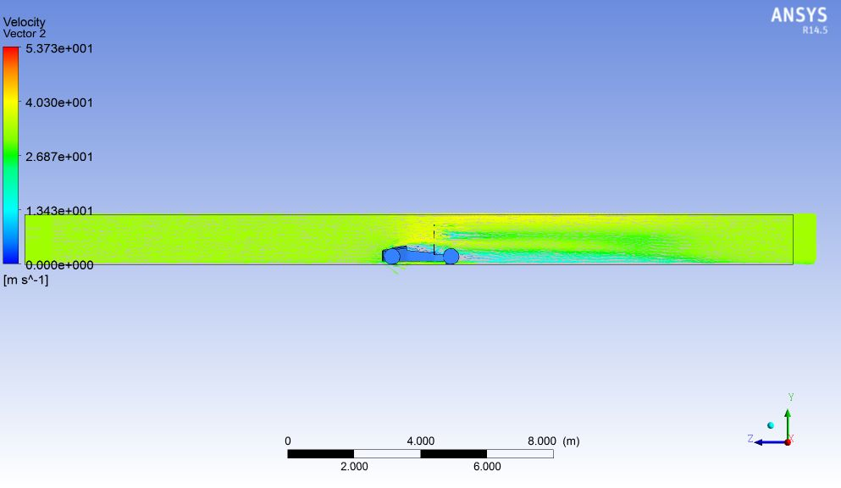
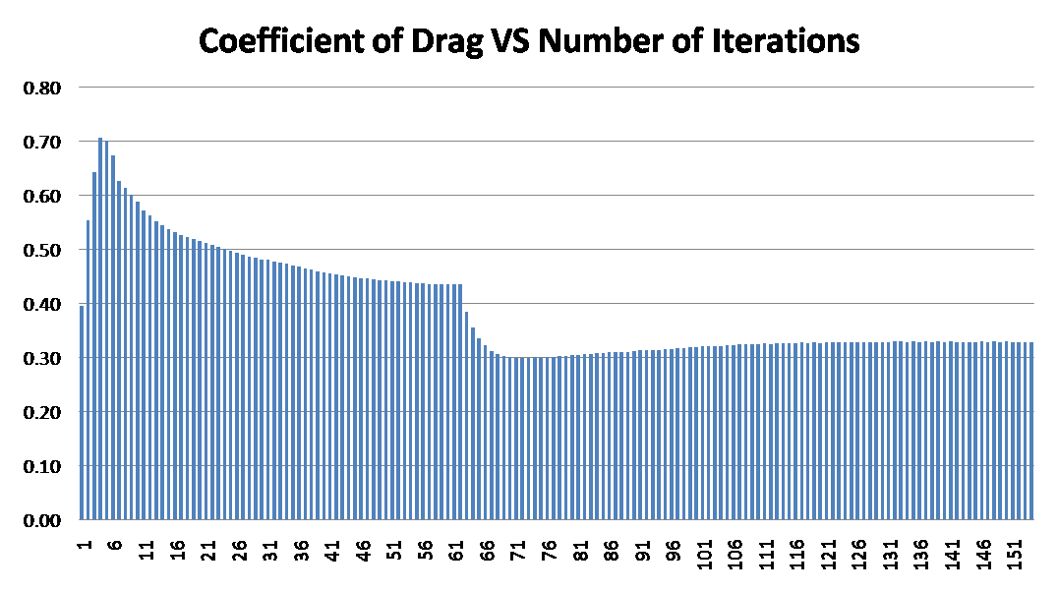
CFD ANALYSIS OF CAR
Inlet Velocity- 33m/s (at the entrance of wind tunnel)
Velocity contour (on horizontal plane)
Inlet Velocity- 33m/s (at the entrance of wind tunnel)
coefficient of drag was found to be 0.32 in second order iteration

Slide 8
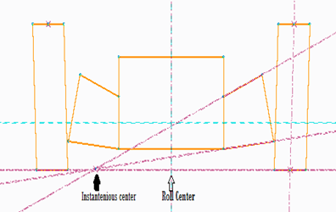
SUSPENSION GEOMETRY
1. Fully independent outboard, non-parallel, unequal length, double A- arm type push-rod suspension system.
Inference from the drawing:-
Track width- 1100/1200mm
Wheel base- 1800mm
Ground clearance- 80mm
Roll centre- On the ground
Scrub radius- 10mm
Kingpin Inclination- 11/2 deg
Camber- +2/0 deg
Alternatives considered:-
Mc-Pherson strut
Pull rod suspension
Load distribution | 1153.565(F) / 1593.144N(R)
Static spring deflection | 9.14 mm
Static Wheel Deflection | 32 mm
Spring stiffness | 46 N/mm
Jounce(Allowable) | 30.5 mm(F)/ 33 mm(R)
Rebound(Allowable) | 29.5 mm(F)/ 32mm(R)
Active no of coils | 7
Mean diameter of spring | 68 mm
Diameter of coil wire | 12 mm
Material Specification
A-Arms – SAE 1018
Push rod – Plain carbon steel (40C8)
Rocker – ENAW6005(A)

Slide 9
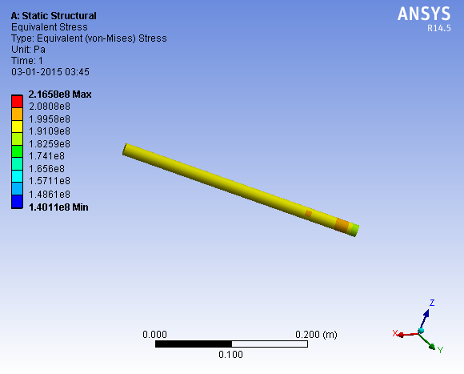
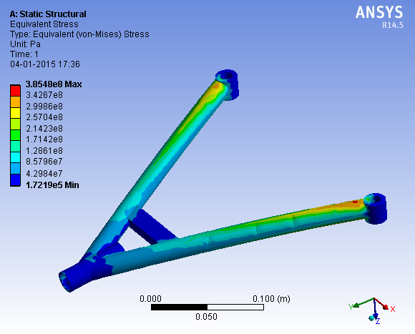
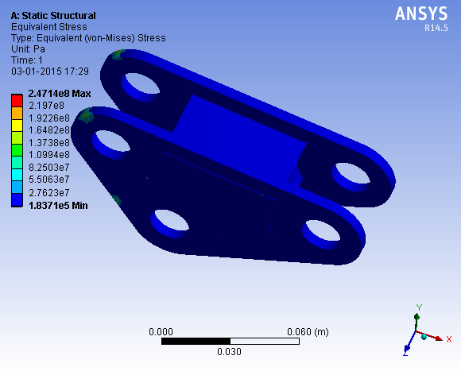
ANALYSIS OF SUSPENSION COMPONENTS
Part | Load (N) | Maximum stress | FOS | Deflection
pushrod | 8000 | 216Mpa | 1.75 | 0.348mm
A-arm | 8000 | 172.Mpa | 2.22 | 4.5mm
Bell crank | 2000 & 800 | 82.5Mpa | 4.6 | 0.00669mm

Slide 10
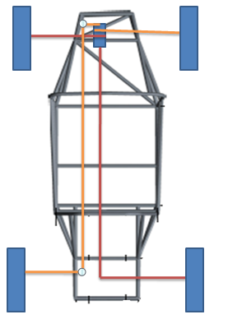
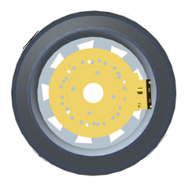
BRAKING SYSTEM
Hydraulically operated Braking System and 2 independent hydraulic circuits.
Disc brakes used on all four wheels.
A dual tandem Master Cylinder used
Diagonal braking circuit is used.
Disc diameter : 220mm
Pedal force : 32Kgf (313.92 N)
Pedal ratio : 5:1
Braking Force:1304.73 N(F)/1167.39 N(R)
Braking Efficiency : 87.1%
Stopping Distance : 16.32m including delay.

Slide 11
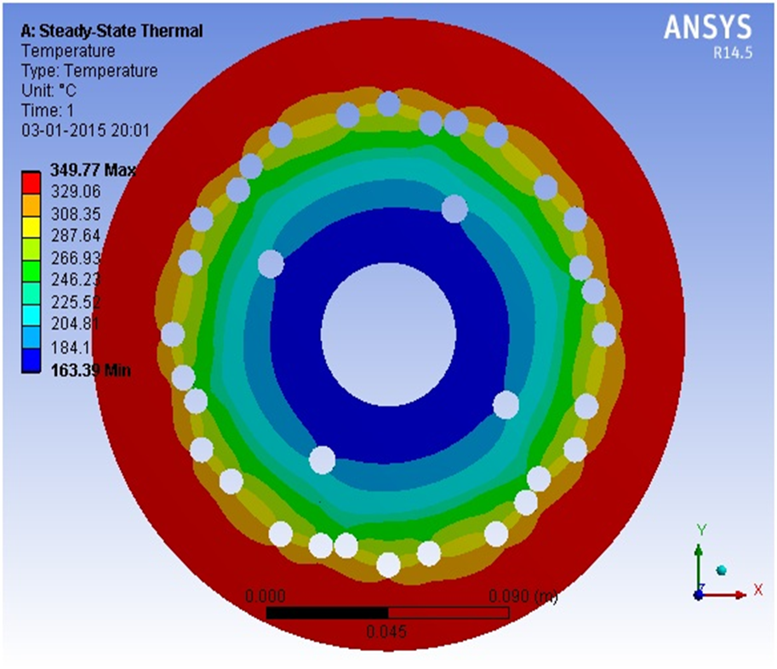
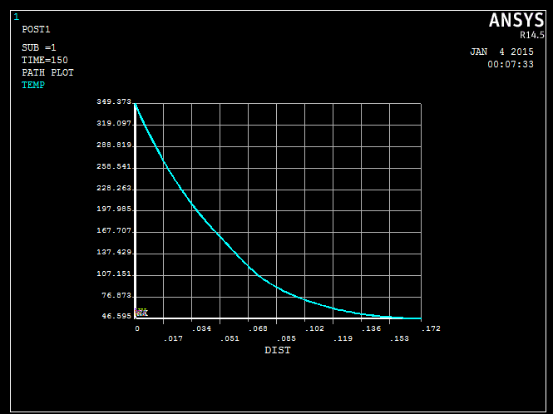
THRMAL ANALYSIS OF DISK
Steady state thermal analysis Input = 1132W h = 40W/m²K
Transient thermal analysis Input temperature = 349.77 deg C h = 40W/m²K

Slide 12
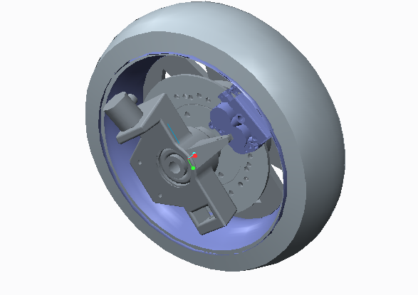
WHEEL ASSEMBLY
Tire specification Front :145/80 R12 Rear : 155/65 R13
Rim specification Alloy wheel rims 304.8mm (F) 330mm (R)
Hub Custom made
Material – 40C8
Syt – 320 Mpa
Knuckle Custom made
ENAW-6005A [AlSiMg (A)]
Syt- 220 Mpa
Sut- 320Mpa

Slide 13
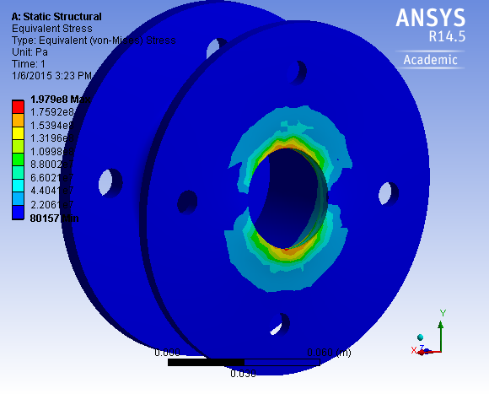
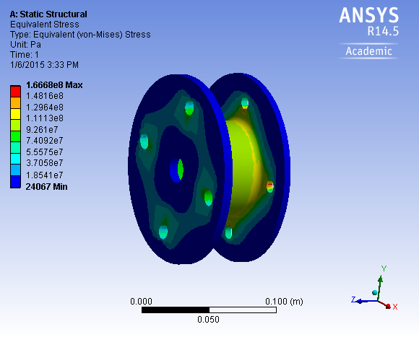
STRUCTURAL ANALYSIS OF HUB
STRESS IN HUB UNDER BENDING Constraint – force applied vertically keeping rear face fixed
Loading condition- 4000N
FOS- 4.3
STRESS IN HUB UNDER BRAKING Constraint – force applied tangentially keeping holes on surface facing the disc
Loading condition- 6000N
FOS- 1.6

Slide 14
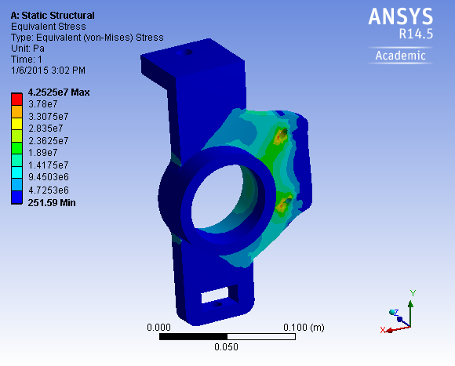
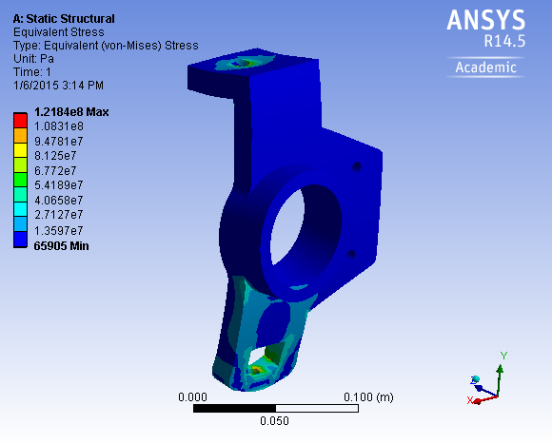
STRUCTURAL ANALYSIS OF KNUCKLE
STRESS IN KNUKLE UNDER BRAKING
Constraint – force applied tangentially in upward direction keeping bearing hole fixed
Load – 4000N
FOS – 5.17
STRESS IN KNUCKLE UNDER BENDING
Constraint – force applied radially upward inside the bearing hole keeping holes for arms fixed
Load – 6000 N
FOS – 1.8

Slide 15
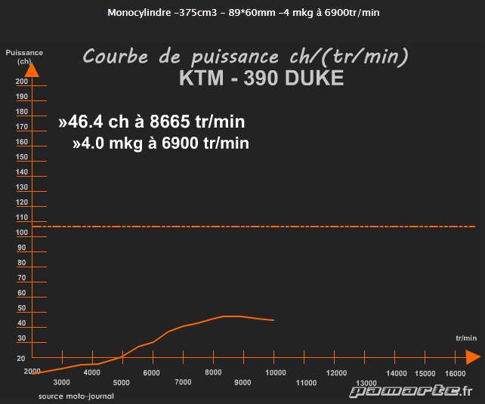
ENGINE AND TRANSMISSION
Engine specification:-
Type- KTM DUKE 390 Engine
Swept volume- 373.27cc
Maximum power- 44bhp @ 9500rpm
Maximum torque- 35Nm @ 7250rpm
Type of fuel used - Petrol
Compression ratio- 12.88 : 1
Rated acceleration- 3.96m/s²
GEAR | GEAR RATIO | SPEED AT MAX. RATED RPM
1st | 2.86:1 | 34.12km/h
2nd | 2.67:1 | 36.63km/h
3rd | 1.42:1 | 68.75km/h
4th | 1.14:1 | 85.72km/h
5th | 0.96:1 | 101.6km/h
6th | 0.84:1 | 116.2km/h
Transmission:-
Type- Manual
Clutch in oil bath/mechanically activated-8 plates
6 speed constant mesh
Differential type- Straight Bevel Gear
Final drive ratio- 6.72

Slide 16
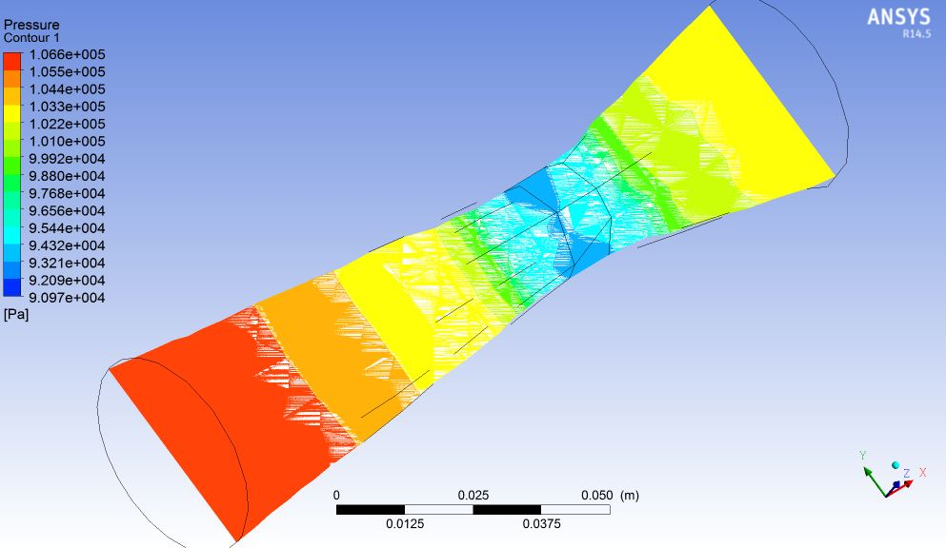
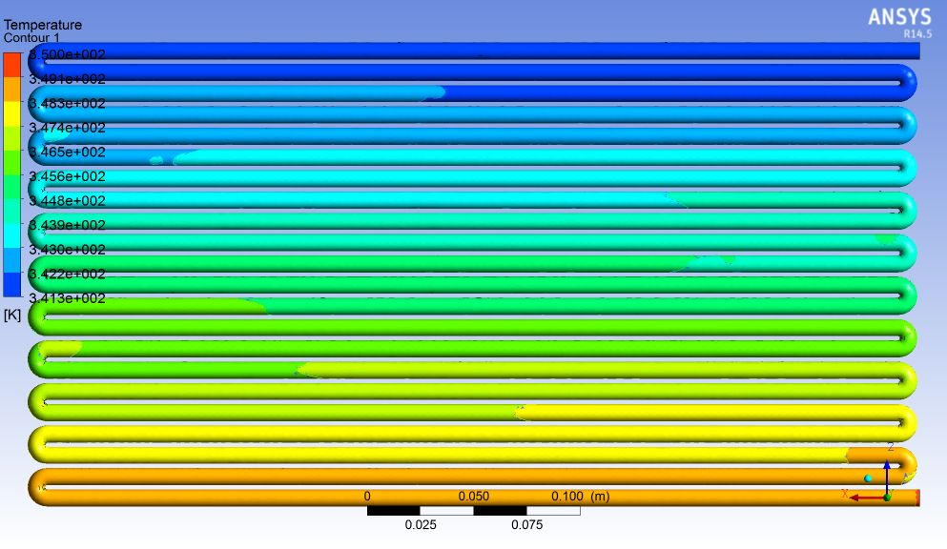
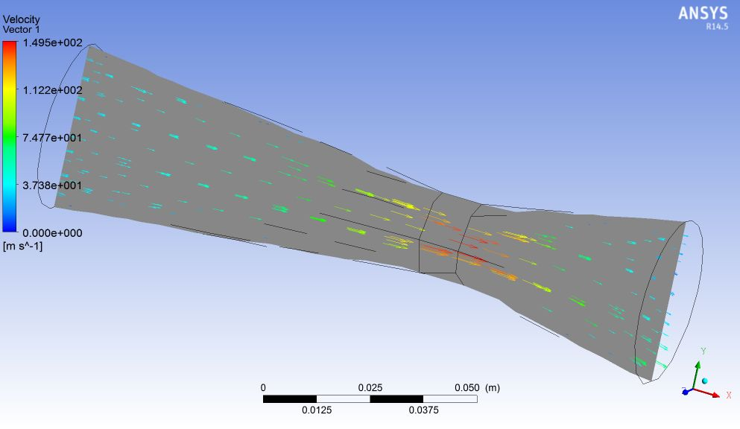
ANALYSIS OF VENTURI AND RADIATOR
PRESSURE CONTOUR
Inlet – 1 atm and 300 k
Outlet – 0.0703 kg/s
Fluid – air only
VELOCITY CONTOUR
THERMAL DISSIPATON OF RADIATOR TUBING
Inlet temp. – 350k
Mass flow rate – 0.025 kg/s
Fluid – water only

Slide 17
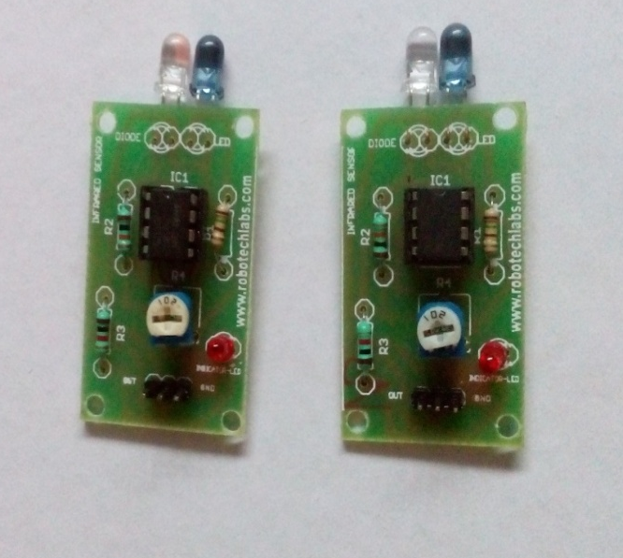
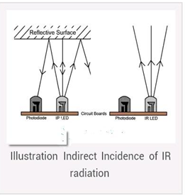
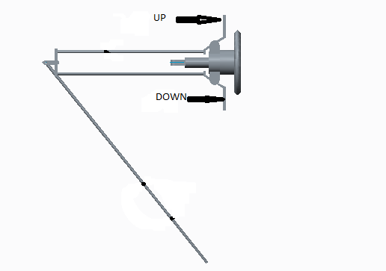
INNOVATION
In our car we are using a Radar type system to locate the position of car behind us within the range of 1.2m.
We are installing a central hub for the complex wire harnesses of KTM Duke 390 which will make fault detection easier and help simplify the circuit.
We are providing gear shifting mechanism impounded with the steering wheel for easy access of driver.

Slide 18
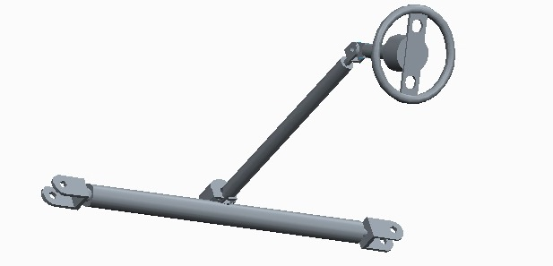
STEERING SYSTEM
Design Specifications
Steering type – Rack and Pinion
Steering Ratio – 5:1
Steering Arm Length – 9.28 cm
Turning Radius = 4.15 m
Steering Effort = 8.06 N
Pinion Diameter – 0.0317 m
Steering Column Diameter – 0.0381 m
Scrub radius – 1 cm
Wheel Caster – +5 deg
Wheel Camber - +2 deg
Wheel Diameter - 0.6 m
Wheel Nominal Diameter – 0.165 m
Steering Column Length – 0.35 m
Wheel Lock to Lock angle – 0.833 rev = 300 deg

Slide 19
SAFETY EQUIPMENTS
Helmet:
Closed face helmet
K 2010
Seat belt: 5 point seat belt
Balaclava:
Which covers drivers head, hair and neck made from acceptable fire resistant material.
Suit:
Fire resistant one price suit
Standards- SFI 3-2A/5 ( or higher)
FIA standard 1986
FIA standard 8856-2000
STATIC/ DYNAMIC VALIDATION TESTS
CHASSIS: Real time prototyping , ergonomics apparatus.
SUSPENSION: Spring test.
BRAKING: Skid pad, stopping distance
STEERING: Ground testing.
ELECTRICAL: Ground testing.
WHEEL : Wheel balancing, Wheel alignment
Performance : Acceleration test, endurance test
Misc :egress test

Slide 20
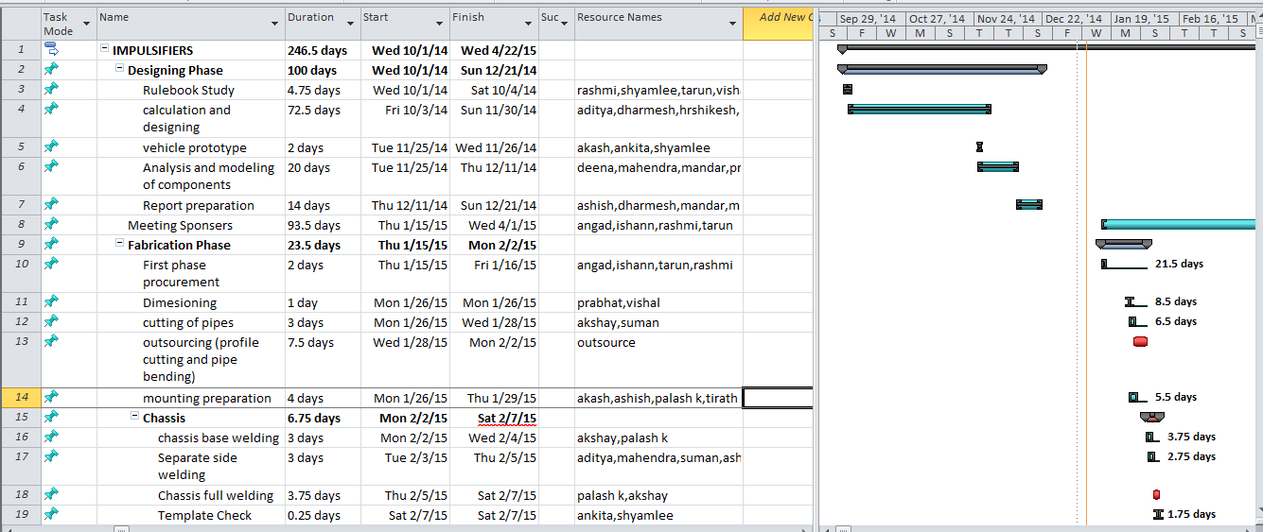
PROJECT PLAN (Microsoft Project)

Slide 21
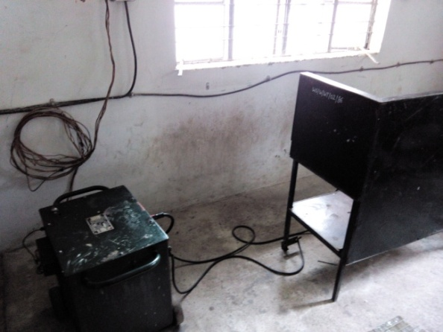
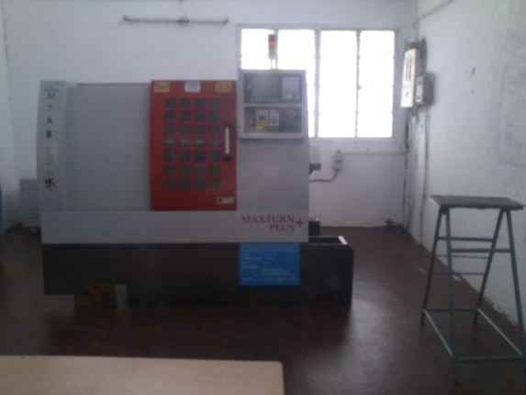
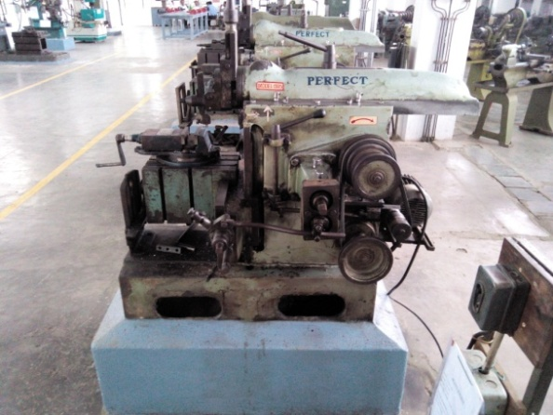
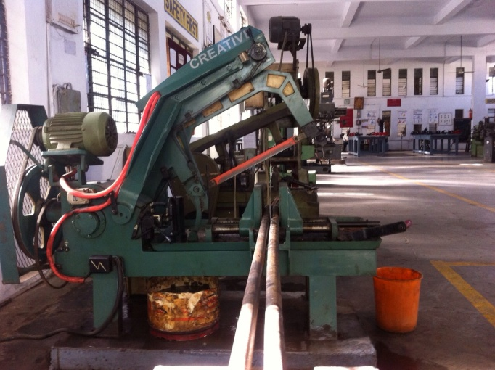
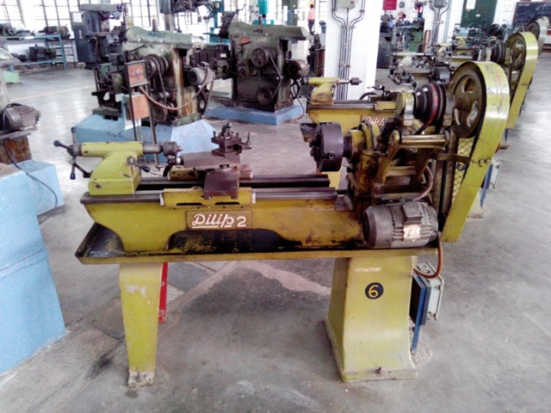
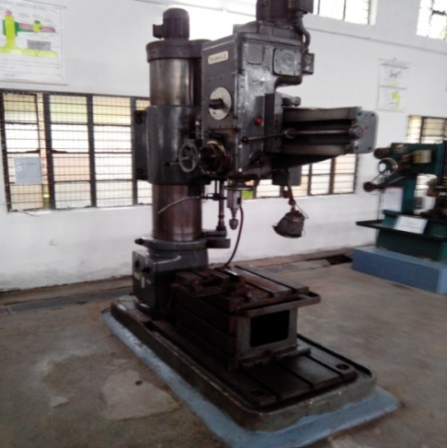
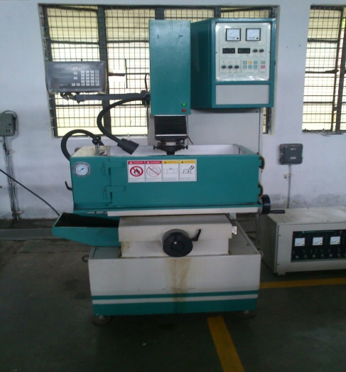
COLLEGE FACILITIES
SERVICE AVAILING FROM OUTSIDE
Profile Cutting
Casting (& Heat Treatment)
Moulding

Slide 22
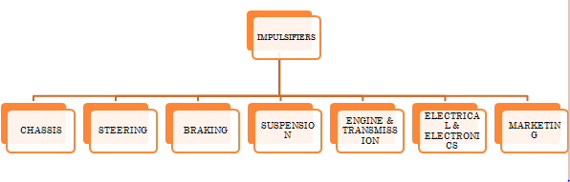
TEAM ORGANISATION CHART
SPONSERSHIS
COLLEGE FUNDS – Rs. 1,00,000(25%)
TEAM CONTRI- Rs.75,000 (Rs.3000 each)
PURTI GROUP
L7 (Hotel Chain)
Ideal Academy of Science, Nagpur
Cadme Technology Solution, Nagpur
Hasan Garage (material sponsor)
Spacewood Furniture
Shells Advertising (marketing)
Ramson Casting Pvt. Ltd. (Machining facilities)
Onkar Furnitures (bending and profile cutter)
Cost
Vehicle Fabrication – Rs.2,80,000
Marketing - Rs. 10,000
Logistics – Rs.40,000
Registration – Rs. 57,000
Tools & equip. – Rs. 15,000
Misc. – RS.20,000
Total Vehicle Assembly- Rs.4,22,000

Slide 23
THANK YOU !!
QUESTIONNAIRE

